Slide 1






Lecture 24:
Conditional Rendering
Course - Web Development - II
-By
Instructor Name
‹#›
welcome@krmangalam.edu.in
Sohna Road,Gurugram,Haryana 122103

Slide 2

| Table of Contents
If/Else
Ternary Operator
References
The End
‹#›

Slide 3

|
Did you know React apps behave like a smart assistant – they show different things depending on the situation?
‹#›

Slide 4
|
Did you know React apps behave like a smart assistant – they show different things depending on the situation?
Yes, React apps behave like a smart assistant because they use Conditional Rendering to display different UI based on conditions.
For example, when data is being fetched, React shows “Loading…”, and once the data is available, it displays the actual content.
This is achieved using JavaScript conditions like if-else or ternary operator inside components.
‹#›

Slide 5
|
IF / ELSE
if-else is used to make decisions in React components, just like in normal JavaScript.
It checks a condition:
If the condition is true → one UI is shown
If the condition is false → another UI is shown
Note :
In React, if-else is written outside JSX, usually before the return.
‹#›

Slide 6
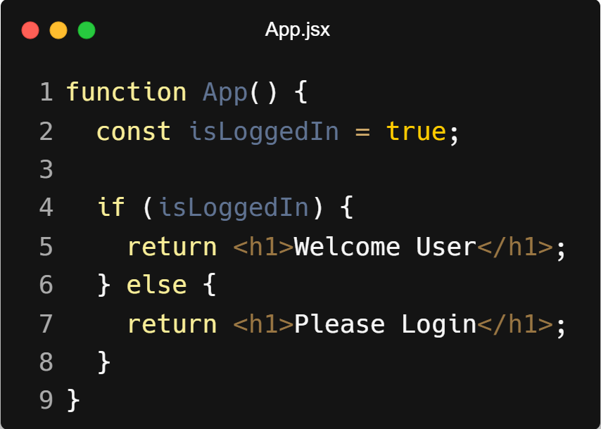
|
IF / ELSE
‹#›

Slide 7
|
IF / ELSE
How it works
React checks the condition (isLoggedIn)
If true → returns "Welcome User"
Else → returns "Please Login"
When to use
When logic is complex
When there are multiple conditions
When code becomes messy in JSX
‹#›

Slide 8
|
Ternary Operator
The ternary operator (? :) is a short way to write if-else in React.
It checks a condition:
If true → first value
If false → second value
Note:
Ternary is used inside JSX, which makes it very useful in React.
‹#›

Slide 9
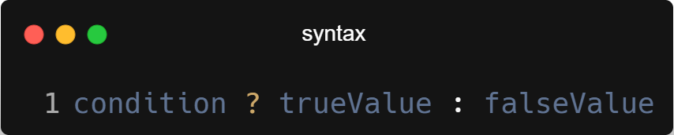
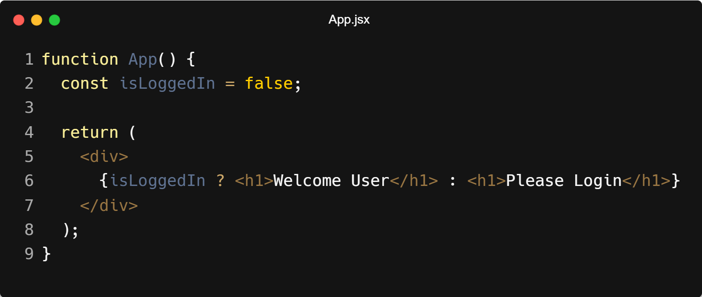
|
Ternary Operator
‹#›

Slide 10
|
Ternary Operator
How it works
React checks isLoggedIn
If true → shows "Welcome User"
If false → shows "Please Login"
When to use
When condition is simple
When you want short and clean code inside JSX
‹#›

Slide 11

| Check Your Understanding
Question : Which is correct way to use condition inside JSX?
Options : a) if (isLoggedIn) <h1>Welcome</h1>
b) {if (isLoggedIn) <h1>Welcome</h1>}
c) {isLoggedIn ? <h1>Welcome</h1> : <h1>Login</h1>}
d) {isLoggedIn && else <h1>Welcome</h1>}
Answer : c) {isLoggedIn ? <h1>Welcome</h1> : <h1>Login</h1>}
Explanation:
JSX does not support if-else directly, so we use the ternary operator (? :) to write conditions inside JSX.
‹#›

Slide 12
| References
MDN Web Docs : Comprehensive and official documentation for JS. 🔗https://developer.mozilla.org/en-US/docs/Web/JavaScript
W3Schools – JS Tutorial : Beginner-friendly JS tutorials with examples and interactive editors. 🔗 https://www.w3schools.com/js/
react.dev - A comprehensive, tutorial-style website that deeply explores core React concepts, including components, state, effects, and hooks, through interactive examples and in-depth explanations.
🔗https://react.dev/
‹#›

Slide 13
Thanks
For
Watching
Course - Web Development - II
‹#›
welcome@krmangalam.edu.in
Sohna Road,Gurugram,Haryana 122103

